Slide 2
Quan tam
1>SQL 2012
2> Basic Architecture p5
Tool
Services
Instances
3>Summary

Slide 3
Objectives
Describe the basic architecture of SQL Server 2012
List the various versions and editions of SQL Server
Explain the role and structure of SLQ Server databases
List the new features of SQL Server 2012
List the process of connecting to SQL Server Instances
Explain script file creation and organization
Explain the process to execute Transact-SQL queries

Slide 4
Introduction
SQL Server is an RDBMS developed by Microsoft.
It provides an enterprise-level data management platform for an organization.
SQL Server includes numerous features and tools that make it an outstanding database and data analysis platform.
It is also targeted for large-scale Online Transactional Processing (OLTP), data warehousing, and e-commerce applications.
SQL Server 2012 is the new version of SQL Server and was launched by Microsoft on March 6, 2012.
One of the major features of this version of SQL Server is that it is available on the cloud platform.
Using SQL Server 2012 not only helps an organization to store and manage huge amount of information, but also to protect and utilize this data at different locations as required.

Slide 5
Basic Architecture of SQL Server 2012
There are various components that form a part of SQL Server 2012.
All the components come together to form the basic architecture of SQL Server 2012.
These components can be represented under three major heads that are shown in the following figure:

Slide 6
Tools 1-2
There are a number of tools that are provided in SQL Server 2012 for development and query management of a database.
Following table lists the different tools available in SQL Server 2012.
^{Tool} | ^{Description}
SQL Server Management Studio (SSMS) | One of the most important tools available in SQL Server 2012 is SSMS. Is an application provided with SQL Server 2012 that helps to create databases, database objects, query data, and manage the overall working of SQL Server.
SQLCMD | Is a command-line tool that can be used in place of SSMS. It performs similar functions as SSMS, but in command format only.
SQL Server Installation Center | Can also be used to add, remove, and modify SQL Server programs.

Slide 7
Tools 2-2
^{Tool} | ^{Description}
SQL Server Configuration Manager | Is used by database administrators to manage the features of the SQL software installed in client machines. Is not available to all users. It can be used to configure the services, server protocols, client protocols, client aliases, and so on.
SQL Server Profiler | Is used to monitor an instance of the Database Engine or Analysis Services.
SQL Server Data Tools (SSDT) | Is an Integrated Development Environment (IDE) used for Business Intelligence Components. It helps to design the database using a tool named Visual Studio.
Connectivity Tools | Includes DB-Library, Open Database Connectivity (ODBC), Object Linking and Embedding Database (OLE DB), and so on. Are used to communicate between the clients, servers, and network libraries.

Slide 8
Services 1-2
Some of the SQL Server 2012 services are as follows:
SQL Server Database Engine
SQL Server Analysis Services
Is a core service that is used for storing, processing, and securing data.
Contain tools that help to create and manage Online Analytical Processing (OLAP).
Is also used for replication, full-text search, and the Data Quality Services (DQS).
Contains tools for managing relational and eXtensible Markup Language (XML) data.
Is used for personal, team, and corporate business intelligence purposes.
Are also used in data mining applications.
Helps to collaborate with PowerPivot, Excel, and even SharePoint Server Environment.

Slide 9
Services 2-2
SQL Server Reporting Services
SQL Server Integration Services
SQL Server Master Data Services
Helps to create, manage, publish, and deploy reports.
Are used for moving, copying, and transforming data using different graphical tools and programmable objects.
Are used for master data management.
Can use the reports in tabular, matrix, graphical, or free-form format.
Can also be created using Reporting Services.
Includes DQS component in Integration Services.
Helps to build high-performance data integration solutions.
Is used for analysis, managing, and reporting information such as hierarchies, granular security, transactions, business rules, and so on.

Slide 10
Instances
All the programs and resource allocations are saved in an instance.
An instance can include memory, configuration files, and CPU.
There can be multiple instances that can be used for different users in SQL Server 2012.
Even permissions for each instance can be granted on individual basis.
All instances work in isolation.
Each instance can be customized as per the requirement.
The resources can also be allocated to the instance accordingly, for example, the number of databases allowed.
Instances can be called as a bigger container that contains sub-containers in the form of databases, security options, server objects, and so on.

Slide 11
Versions of SQL Server
The first version of SQL Server was released in the year 1989.
After this, there have been new versions released almost every year, with the latest one being SQL Server 2012.
Following table lists different versions of SQL Server:
^{Version} | ^{Year}
SQL Server 1.0 | 1989
SQL Server 1.1 | 1991
SQL Server 4.2 | 1992
SQL Server 6.0 | 1995
SQL Server 6.5 | 1996
SQL Server 7.0 | 1998
SQL Server 2000 | 2000
SQL Server 2005 | 2005
SQL Server 2008 | 2008
SQL Server 2008 R2 | 2010
SQL Server 2012 | 2012

Slide 12
Editions of SQL Server 1-3
The main editions of SQL Server 2012 are as follows:
Enterprise
Standard
Business Intelligence
Is recurrently released edition on most versions of SQL Server.
Is the basic edition of SQL Server that supports fundamental database and reporting and analytics functionality.
Is a new edition introduced for the first time in SQL Server 2012.
Is the full edition of SQL Server which contains all the features of SQL Server 2012.
It supports features like PowerView, xVelocity, Business Intelligence services, virtualization, and so on.
It does not support critical application development, security, and data warehousing.
Supports basic database, reporting and analytics functionality, and also business intelligence services.
Supports features such as PowerPivot, PowerView, Business Intelligence Semantic Model, Master Data Services, and so on.
Notes:
Recurrently: định kỳ

Slide 13
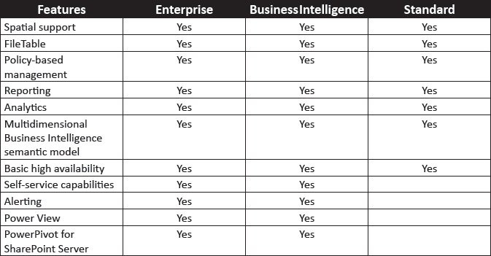
Editions of SQL Server 2-3
Following table shows a comparison of the features available for the different editions of SQL Server 2012:

Slide 14
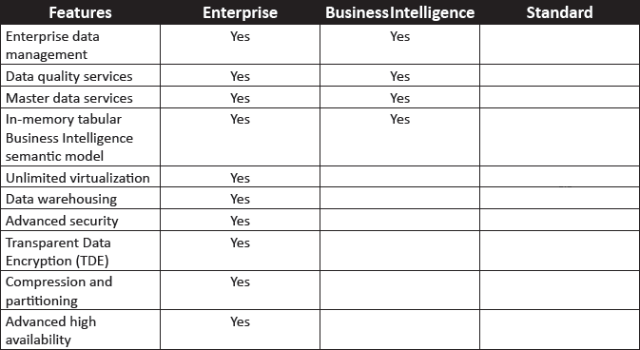
Editions of SQL Server 3-3
There are also other editions available such as:
Express edition - is a free edition of SQL Server 2012.
Web edition - is used for Internet-based Web services environment.
Developer edition - is used by programmers specifically for development, testing, and demonstration purposes.

Slide 15
Role and Structure of Object Explorer 1-2
The structure of Object Explorer in SQL Server 2012 is shown in the following figure:
The structure includes databases, security, server objects, and replications.
It also includes features such as AlwaysOn High Availability, Management, Integration Services Catalogs, and so on.

Slide 16
Role and Structure of Object Explorer 2-2
The various components in the Object Explorer are as follows:
Databases
Contains a collection of databases that stores a specific set of structured data.
Security
Used to provide flexible and trustworthy security configuration in SQL Server 2012.
Server Objects
Used to monitor activity in computers running an instance of SQL Server.
Replication
Used to copy and distribute data and database objects from one database to another, and then, to synchronize between databases to maintain consistency.
AlwaysOn High Availability
Used for high availability and disaster recovery.
Management
Used to manage policies, resources, events, maintenance plans, and so on.
Includes logins, roles, credentials, audits, and so on.
Is generally used for applications that require high uptime and failure protection.
Integration Services Catalogs
Stores all the objects of the project after the project has been deployed.

Slide 17
New Features of SQL Server 2012
Statistics properties
Failover clustering enhancements
SQL Azure
Big data support
Data-tier Applications
Data Quality Services
Full Text Search
SQL Server Installation
Server mode
Audit features
Selective XML Index
Master Data Services
PowerView

Slide 18
Connecting to SQL Server Instances 1-3
SSMS is used to connect to SQL Server instances.
SSMS is a tool used for creating, querying, and managing the databases.
To open SSMS, connect to SQL Server 2012 by specifying the sever information and login credentials which includes username and password.
The detailed steps to connect to SQL Server instance are as follows:
1
Click Start → All Programs → Microsoft SQL Server 2012 → SQL Server Management Studio.
2
In the Connect to Server dialog box, select the Server type as Database Engine.
3
Type the Server name.
4
Select either Windows Authentication or SQL Server Authentication, provide the required Login and Password, and click Connect.

Slide 19
Connecting to SQL Server Instances 2-3
Following figure shows the Connect to Server dialog box:

Slide 20
Connecting to SQL Server Instances 3-3
Following figure shows the SSMS window:

Slide 21
Creating and Organizing Script Files 1-2
Script files are files that contain a set of SQL commands.
A script file can contain one or more SQL statements.
The script files are stored in .sql format in SQL Server 2012.
The conceptual layers in which the script files must be organized are shown in the following figure:

Slide 22
Creating and Organizing Script Files 2-2
A solution is a file in which all the projects in SQL Server 2012 are saved.
This acts as a top-most node in the hierarchy and is stored as a text file with .ssmssln extension.
A project comes under a solution node and there can be more than one project in SQL Server 2012.
All the data related to database connection metadata and other miscellaneous files are stored under a project. It is stored as a text file with .ssmssqlproj extension.
The script files are the core files in which the queries are developed and executed. The scripts have a .sql extension.

Slide 23
Transact-SQL Queries 1-2
The queries typed in Transact-SQL and saved as .sql files can be executed directly in the SSMS query window.
The steps to execute Transact-SQL queries are as follows:
1
In the query window, select the code to be executed.
2
On the SSMS toolbar, click Execute. OR
On the Query menu, click Execute. OR
Press F5 or Alt+X or Ctrl+E.

Slide 24
Transact-SQL Queries 2-2
Following figure shows the results of a sample executed query.
The query results can be displayed in three different formats namely, grid, text, and file view.

Slide 25
Summary
The basic architecture of SQL Server 2012 includes tools, services, and instances.
The three editions of SQL Server are Enterprise, Standard, and Business Intelligence.
The structure of SQL Database includes databases, security, server objects, replications, AlwaysOn High Availability, Management, Integration Services Catalogs, and so on.
SSMS is used to connect to SQL Server Instances.
SSMS is a tool used for developing, querying, and managing the databases.
The script files should be stored in .sql format in SQL Server 2012.
The queries typed in Transact-SQL and saved as .sql files can be executed directly into the SSMS query window.

